Slide 1
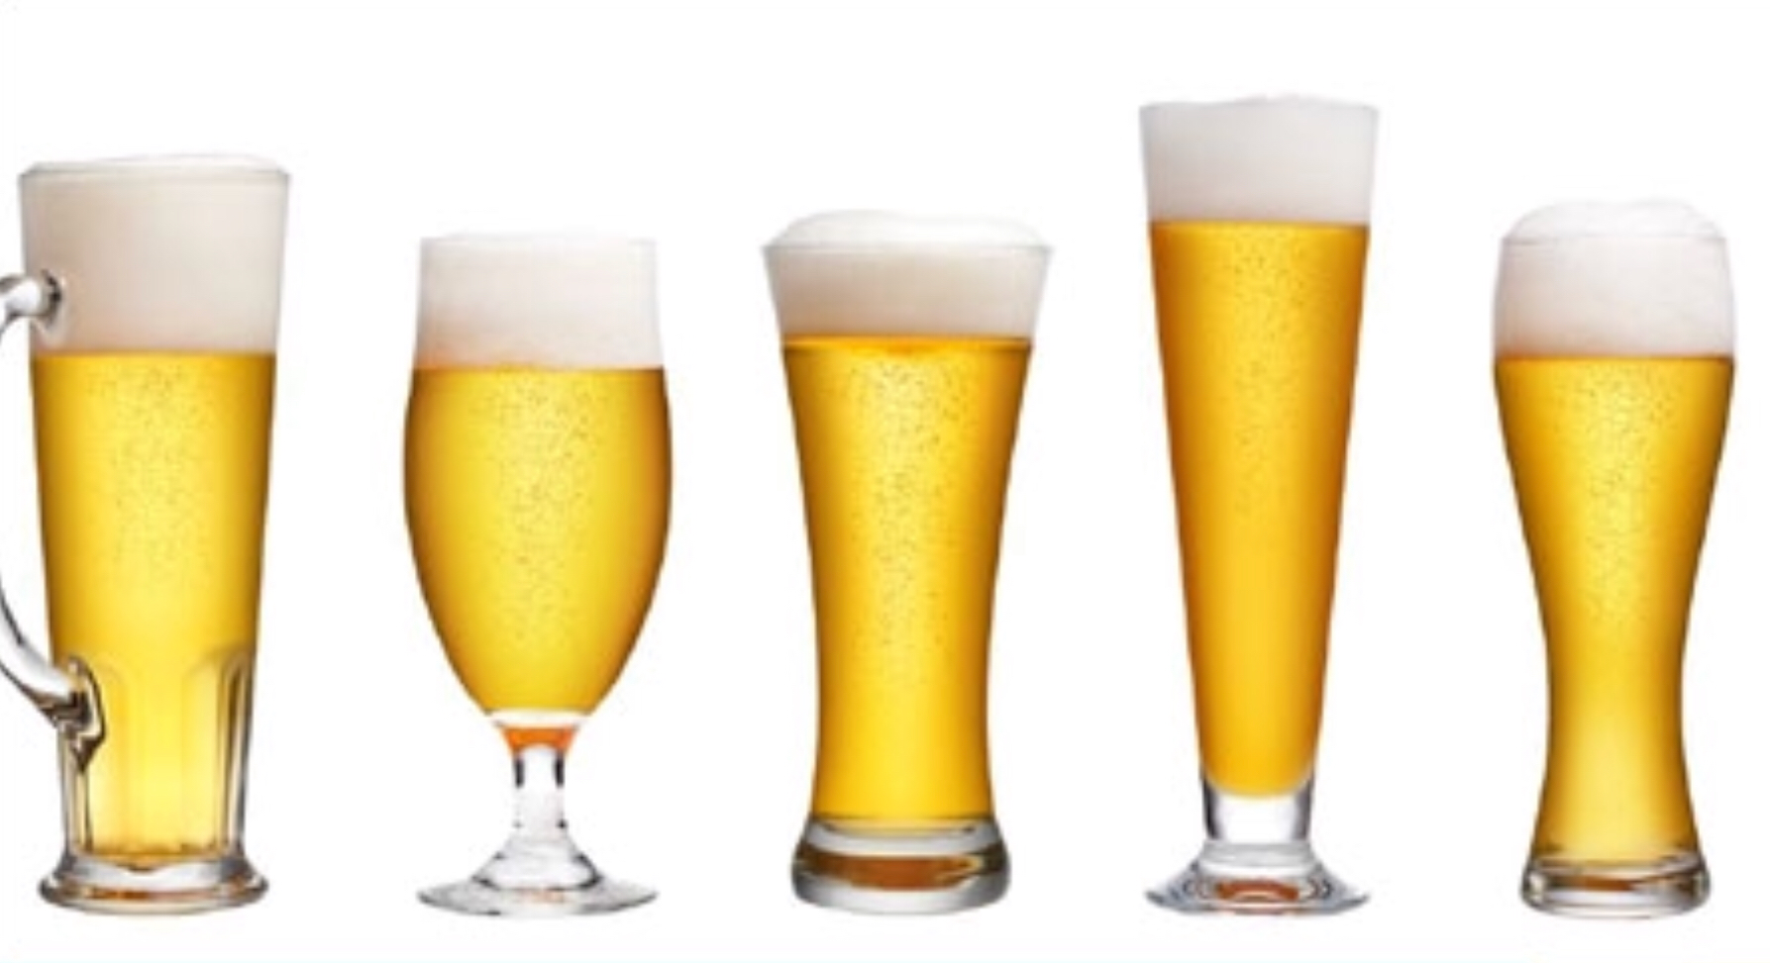
Stats 2 Crew Consulting
Beers and Breweries
Data Base Data Discovery

Slide 2
Deliverables
Met with client to review Brewery data and ensure quality
1
After data discovery generated findings and recommendations for future implementation
2
Spatially correlated available data for high level review, potential locations for brewery expansion
4
Determined which Beers exhibited certain values for Alcohol by Volume (ABV) and International Bitterness Units (IBU)
3

Slide 3
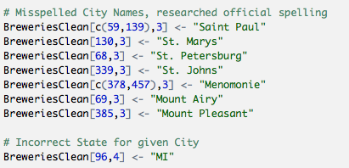
Data Investigation: Breweries
While reviewing the Breweries data set it appeared that duplicates could exist. Via base R sorting and text functions cleanup of City spellings and duplicated Brewery names was done. In particular we found that City names containing “St” were missing “.” and others had “Mt.” rather than “Mount”. Google search was used to verify Names. One name was misspelled twice, Menomonie in WI. It was also found that City name ”Marquette” was not found in MA, only in MI.

Slide 4
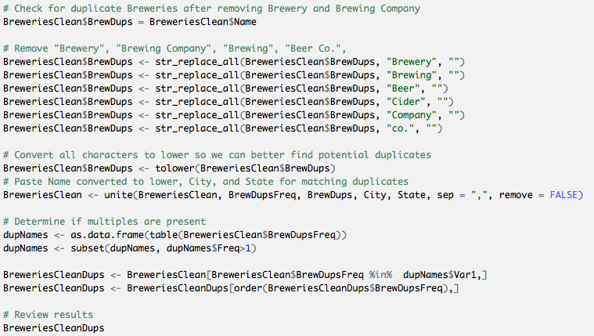
Data Investigation: Breweries
To better identify what could truly be duplicated rows, a combination of an adjusted Name, City, and State was used to determine frequency of occurrence. If that value was greater than 1 further investigation was necessary.

Slide 5
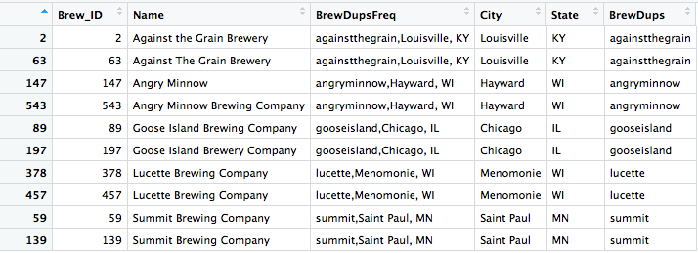
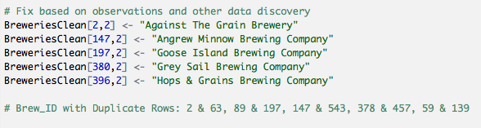
Data Investigation: Breweries
From the solutions that were developed the following Breweries were found as potential duplicates within the data set.

Slide 6
Data Investigation: Breweries
After implementation of string functions and some fuzzy string logic the following were found to be potential duplicate records. The top instance below requires domain expertise given the unique nature of “Catawba Valley” compared to “Catawba Brewing”.

Slide 7
Recommendations for Higher Quality Data
Database layer validations
Validate uniqueness of names of beers and breweries
Have States set as Enums
Build a web application to collect and verify data
Since we are not working with Big Data here, it would be good to have tooling in place to have api integration with Google maps api to verify name and address of breweries.
This application can have more sophisticated validation logic
This application can leverage task scheduling to pull data
Consume data in many formats. CSV, JSON, XML, etc.

Slide 8
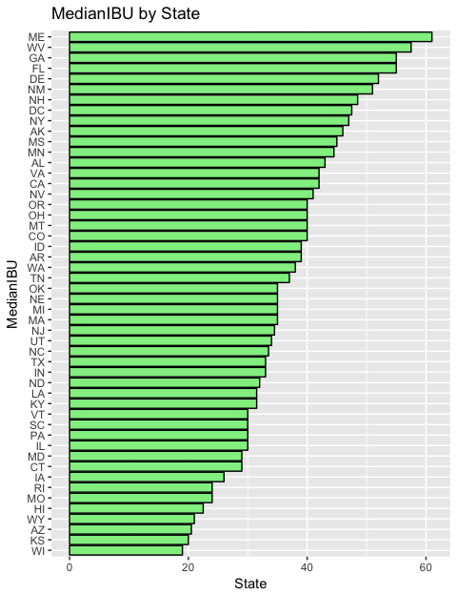
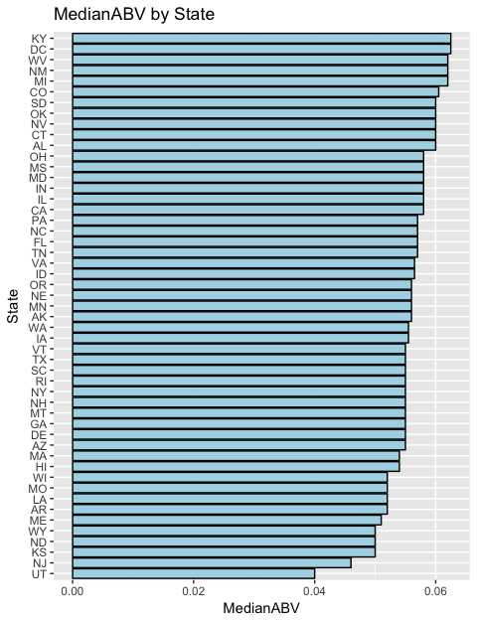
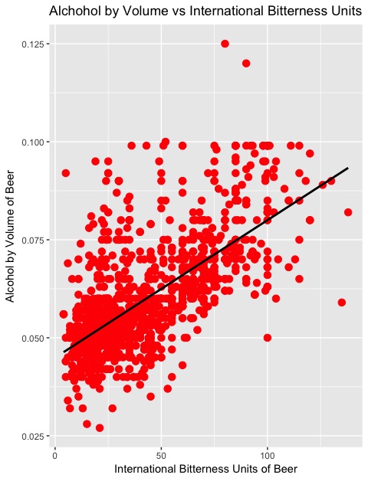
Visualizing Results

Slide 9
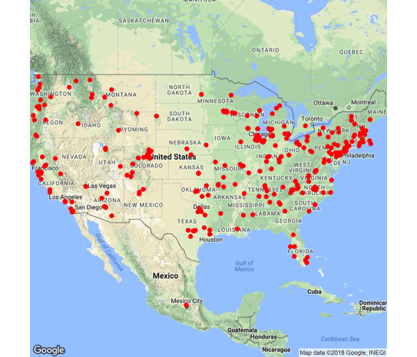
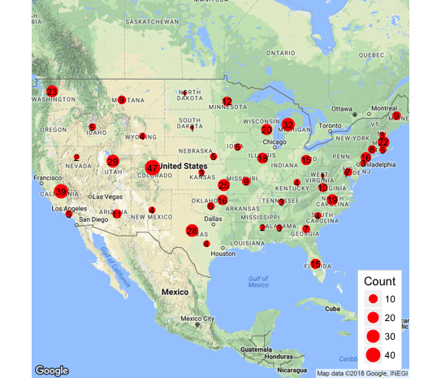
Spatial Results

